Slide 1





Sentimental analysis of restaurant Review
Using Naïve Bayes
Team Members: GUIDE:SHILPA HARIRAJ
Chethan K J
Amith Gowda E
Bharath N S
Jashwanth Gowda B R
Anusha R
Disclaimer: The content is curated for educational purposes only.

Slide 2
Sentimental analysis of restaurant Review
OUTLINE
Abstract
Problem Statement
Aims, Objective & Proposed System/Solution
System Design/Architecture
System Development Approach (Technology Used)
Algorithm & Deployment
Conclusion
Future Scope
References
Video of the Project
Notes:
These are the list of chapters that we are going to cover in these foundation codes. Those are chapter one what are AI and ML? chapter 2 applied Python programming in AI, and chapter 3 is exploratory data analysis for ML.

Slide 3
Abstract
Sentimental analysis of restaurant Review
Sentiment Analysis of Restaurant Reviews is a machine learning project aimed at classifying customer reviews into positive and negative categories. This project leverages Natural Language Processing (NLP) techniques and various machine learning algorithms to analyze textual data and predict sentiment. The project’s outcome will provide valuable insights into customer satisfaction and areas of improvement for restaurants, contributing to the enhancement of the overall dining experience.

Slide 4
Problem Statement
Sentimental analysis of restaurant Review
The problem statement is to find whether the Review of the Restaurant is positive or Negative . There are different types of reviews given by the customers after completing eating food. It might be either positive and negative.so we need to predict the how much percentage of good review of Entire dataset.

Slide 5
Aim and Objective
Sentimental analysis of restaurant Review
Aim and Objective Aim:
The aim of the Sentiment Analysis of Restaurant Reviews project is to develop a machine learning model that can accurately classify customer reviews into positive, negative, or neutral categories. This classification can provide valuable insights into customer satisfaction and areas of improvement for restaurants.
Objectives:
To develop a machine learning model that can accurately classify restaurant reviews into positive and negative.
To provide actionable insights to restaurants based on the sentiment analysis, helping them improve their services and enhance customer satisfaction.

Slide 6
Proposed Solution
Sentimental analysis of restaurant Review
The proposed solution for the Sentiment Analysis of Restaurant Reviews project is to develop a machine learning model that can accurately classify the sentiment of the reviews using naïve bayes multinomial algorithm.

Slide 7
System Architecture
Sentimental analysis of restaurant Review
Data Collection and Preprocessing
• The first step in the restaurant review system architecture is collecting and preprocessing the data. Data can be collected from various sources such as online review platforms, social media, or direct customer feedback.
• Preprocessing involves cleaning the data, removing irrelevant information, and transforming the text into a suitable format for analysis.
System Integration and Real-time Analysis
• The sentiment analysis component is integrated into the restaurant review system, enabling real-time analysis of incoming reviews.
• The system can provide insights on overall customer sentiment, identify specific issues or areas of improvement, and track changes over time.
• The analyzed sentiment data can be further utilized for decision-making, such as recommending improvements, identifying popular dishes, or monitoring customer satisfaction trends.

Slide 8
System Deployment Approach
Sentimental analysis of restaurant Review
Model Evaluation: Evaluate the model's performance using metrics such as accuracy, precision, recall, F1-score, or confusion matrices on the test dataset. | Training the Model: Split the dataset into training and testing sets, then train the selected model on the training data.
Deployment: After satisfactory evaluation, deploy the trained model to the restaurant review system. This involves integrating the model into the system's architecture and ensuring it can handle real-time data, making predictions on incoming reviews. | Monitoring and Updating: Regularly monitor the performance of the deployed model and update it periodically with new data to keep it relevant and accurate.

Slide 9
Algorithm & Deployment
Sentimental analysis of restaurant Review
Naïve Bayes Algorithm – multinomial model
The Naive Bayes algorithm is a probabilistic machine learning method used for classification tasks. It’s based on Bayes’ theorem and makes a ‘naive’ assumption that each feature in the dataset is independent of each other. This means that the presence or value of one feature does not affect the presence or value of any other feature. Despite this simplification, Naive Bayes often performs well in practice and is particularly popular in text classification tasks, such as spam filtering or sentiment analysis. Multinomial Naive Bayes: This type is used when the features represent counts or frequency of events.

Slide 10
Conclusion
Sentimental analysis of restaurant Review
The Sentiment Analysis of Restaurant Reviews project successfully developed a machine learning model capable of classifying customer reviews into positive or negative categories. The project demonstrated the effectiveness of Natural Language Processing (NLP) techniques and machine learning algorithms in analyzing textual data and predicting sentiment.

Slide 11
Future Scope
Sentimental analysis of restaurant Review
Multilingual Support : The system could be expanded to support reviews in multiple languages, making it more useful for global businesses.
Aspect-Based Sentiment Analysis : Instead of just classifying the overall sentiment of a review, the system could be improved to perform aspect-based sentiment analysis. This would involve identifying specific aspects of the restaurant (like food, service, ambiance, etc.) mentioned in the review and determining the sentiment towards each aspect.
Integration with Other Data Sources : The system could be integrated with other data sources like social media, customer surveys, etc., to get a more comprehensive view of customer sentiment.
Predictive Analysis : Based on the sentiment analysis, the system could be enhanced to predict future trends, like customer satisfaction levels or potential areas of improvement.

Slide 12
Sentimental analysis of restaurant Review
Reference
https://www.javatpoint.com/machine-learning-naive-bayes-classifier
https://www.analyticsvidhya.com/blog/2017/09/naive-bayes-explained/
Notes:
Reference
These are the references for this session.
12

Slide 13
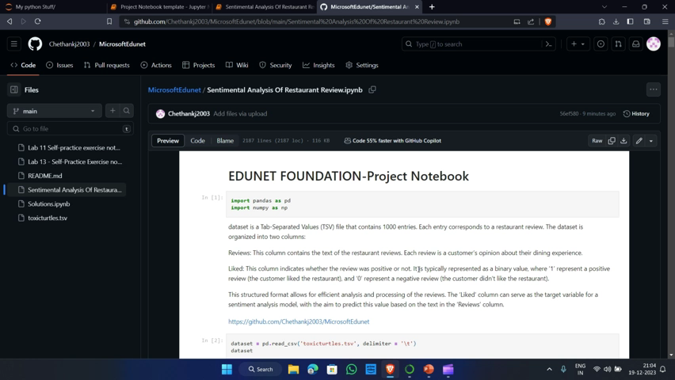
Sentimental analysis of restaurant Review

Slide 14
Sentimental analysis of restaurant Review
Thank you!
Notes:
thank you very much for joining this PPT, keep learning.
14

